Slide 1
Evaluator Instructions (Test Set)
Your task: You will review 15 analysis outputs. For each output, assign 0–3 ratings for the listed metrics based on the provided definitions and the dataset description.
Use the prompt + dataset card + shown results to judge whether choices are reasonable.
Analyses variants can be very similar, this is acceptable
Don’t evaluate quality of the log’s appearance (family/type, filters, […]), just evaluate the information in the log
Don’t focus on formatting or language details (except when it’s relevant to the quality, e.g. value range for axis or outlier handling).
If a step (e.g. aggregation) is not needed, it is correct to keep it blank (“none”)
Sometimes filter decisions make sense, even though they weren’t requested in the prompt, that’s the right choice and leads to the highest score
Assume plots are technically correct if the stated processing decisions are plausible.
Annotator ID (or name/pseudonym): 4
Field / Discipline (e.g., Computer Science): Project management in software environment
Qualification / Role (closest match; e.g., Data Science student, BSc in Data Science, BI manager): Product owner
Gender: male
Age: 31
Please complete these information

Slide 2
Explanation of the experimental design
Meaning of Evaluation Metrics
perceived_analysis_difficulty: How hard the prompt itself feels (ambiguity, elements to take into account, analysis complexity).
task_choice_quality: How appropriate the chosen analysis family/type is for the prompt (descriptive [What is happening?], diagnostic [Why is it happening?], predictive [What will happen?], prescriptive [What should we do?] and the respective analysis type of each category).
data_scope_quality: How reasonable the filters + column choices together are, given the prompt and dataset card.
prep_and_aggregation_quality: How appropriate the prep steps and aggregations are.
summary_quality: Does the written summary faithfully reflect the plots/numbers and/or add useful information?
visualization_helpfulness: Do the plots materially help to understand the answer? Does it cover the whole requested analysis?
analysis_request_fulfilment: Overall, if you were the person asking this question, does this output feel like it fulfils the analysis request?
Evaluation scale (0-3)
0 – Poor: Clearly wrong / off; would mislead a stakeholder.
1 – Weak: Partly reasonable but with major issues or gaps.
2 – OK: Mostly reasonable; only minor issues that don’t change the main takeaway.
3 – Strong: Clearly appropriate and high-quality; no substantive issues.

Slide 3
Explanation of the dataset
Short description of the data (domain view)
General context: The data describes production operations in a manufacturing environment. Each row represents a single operation (e.g., drilling, milling) within a production order. A production order can consist of multiple operations. The data includes planned dates, actual dates, cycle times and various schedule deviations (TA).
Field definitions
pps_order_id: Unique ID of a production order
pps_order_pos_id: Unique ID of the operation within the order (one order consists of multiple operations)
resource_group: Operations are executed on specific machine groups / resource groups (e.g., CNC milling, drilling machines)
plan_start: Planned operation start (date, day-level granularity)
ist_start: Actual start (date, day-level granularity)
plan_ende: Planned end (date, day-level granularity)
ist_ende: Actual end (date, day-level granularity) (if available)
status: Operation status (e.g., “in progress”, “finished”)
avg_type: Operation type (drilling, milling, assembly, etc.), more specific than resource_group
ist_dlz: Cycle time / Lead time (in days), computed as ist_ende minus ist_start
ta_zugang: Start schedule deviation (TA for Terminabweichung) (in days), computed as ist_start − plan_start; positive = start occurred later than planned
ta_abgang: End schedule deviation (TA for Terminabweichung) (in days), computed as ist_ende − plan_ende; positive = end occurred later than planned
ta_rel: Lead-time (or cycle time) deviation (in days) from planned to actual lead time, computed as ta_abgang − ta_zugang; positive = lead time was longer than planned
ta_status: Indicates whether the operation ran with schedule deviation (“mit TA”) or without schedule deviation (“ohne TA”)
Dataset summary (rows/cols, uniques, ranges, missingness)
Dataset (complete): 14 columns, 19887 rows
pps_order_id: 5629 unique values (order id)
pps_order_pos_id: Typically values such as 10, 20, 30 and so on, representing the sub ids within one order
resource_group: 21 categories, most common are “Fräsen Gruppe Kleinteile” (2837), “Sägen” (2463), “Montage” (2317) and “Schleifen-Gruppe” (2036)
plan_start: earliest date on 18th of December 2023 and latest date on 30th of April 2025
ist_start: earliest date on 12th of August 2023 and latest date on 14th of May 2025
plan_ende: earliest date on 1st of May 2024 and latest date on 30th of April 2025
ist_ende: earliest date on 13th of August 2023 and latest date on 16th of April 2025, 723 missing values due to unfinished operations
status: 2 categories, fertiggemeldet (19164), laufend (723)
avg_type: 159 categories, most common are “Rohmaterial auf Länge sägen“ (2357), „Kleinbauteile schlichten“ (1883), „Funktionsprüfung“ (1882), „Profilschleifen“ (1702)
ist_dlz: all values between 0 and 36, but typically 1 day, 723 missing values due to unfinished operations
ta_zugang: values typically between -15 and 3 days, but some big outliers, median at -2 days
ta_abgang: values typically between -18 and 1 days, but some big outliers, median at -4 days, 723 missing values due to unfinished operations
ta_rel: values typically between -3 and 0 days, but some big outliers, median at -1 day, 723 missing values due to unfinished operations
ta_status: 3 categories, “ohne TA“ (meaning: everything on time) (13670), „mit TA“ (meaning: something not on time) (5494), „TA nicht erreichbar“ (meaning: operation still running and already something late) (723)

Slide 4
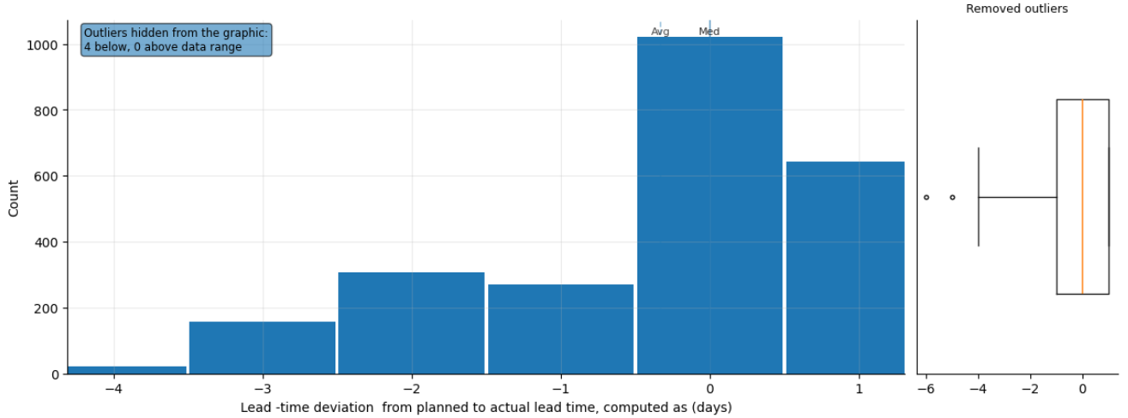
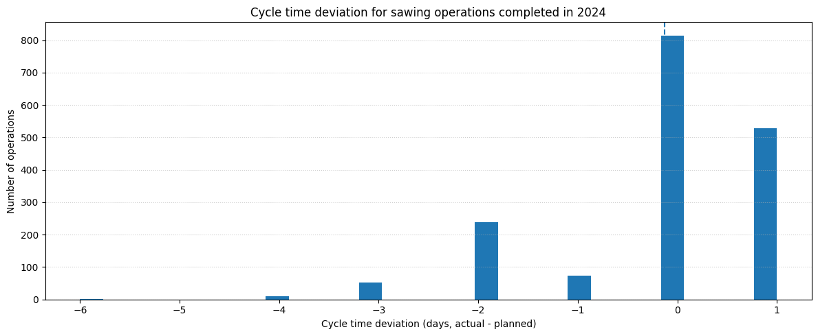
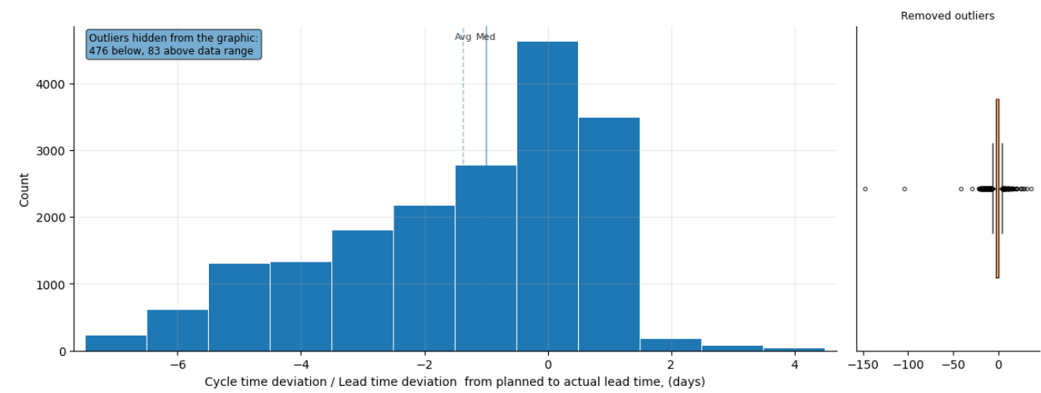
Prompt 1: Display the distribution of cycle time deviation for sawing operations with completion in 2024.
Metric / Analysis | Evaluation (0 to 3)
Family/type: descriptive, distribution
Filters: resource_group == Sägen;
ist_ende >= 2024-01-01; ist_ende < 2025-01-01
Columns: ta_rel
Prepare: Remove rows with missing required values
(ta_rel)
Aggregate: none
Verify status: warn (check summary)
Summary: Sawing operations in 2024 finished on average 0.34 days early, with most deviations between −3 and +1 days. A few sawings were as early as −6 days or as late as +1 day. Investigate causes of extreme early finishes.
perceived_analysis_difficulty | 3
task_choice_quality | 3
data_scope_quality | 3
prep_and_aggregation_quality | 3
summary_quality | 3
visualization_helpfulness | 3
analysis_request_fulfilment | 3
Family/type: descriptive, distribution
Filters: resource_group == Sägen;
ist_ende >= 2024-01-01; ist_ende < 2025-01-01
Columns: cycle_dev_days (actual − planned cycle time)
Prepare: Drop rows with missing start/end times
Aggregate: none
Verify status: warn (check summary)
Summary: Sawing operations in 2024 ran on average 0.13 days faster than planned, with most cycle time deviations between −2 and +1 days and extremes from −6 to +1 days.
perceived_analysis_difficulty | 3
task_choice_quality | 3
data_scope_quality | 3
prep_and_aggregation_quality | 3
summary_quality | 3
visualization_helpfulness | 2
analysis_request_fulfilment | 3
Family/type: descriptive, distribution
Filters: none
Columns: ta_rel
Prepare: Standardize missing-value labels; Clean up text
(trim spaces)
Aggregate: none
Verify status: warn
Summary: Computed distribution of ta_rel (days):
n=19164, mean≈-1.59, range≈[-148.00, 36.00].
perceived_analysis_difficulty | 3
task_choice_quality | 3
data_scope_quality | 1
prep_and_aggregation_quality | 3
summary_quality | 2
visualization_helpfulness | 3
analysis_request_fulfilment | 0

Slide 5
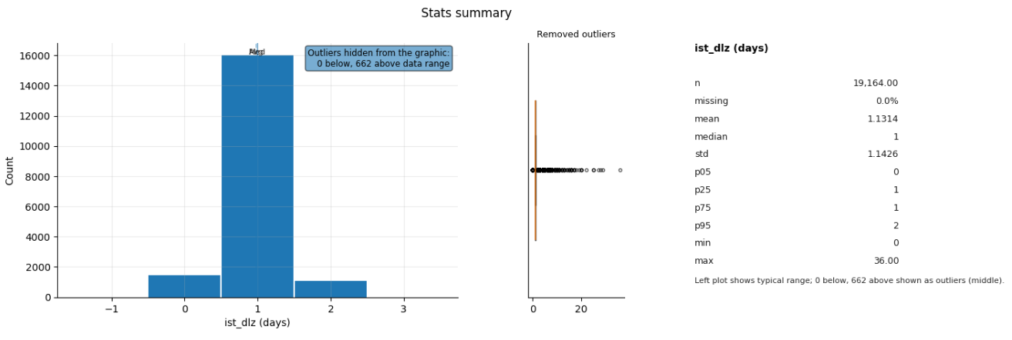
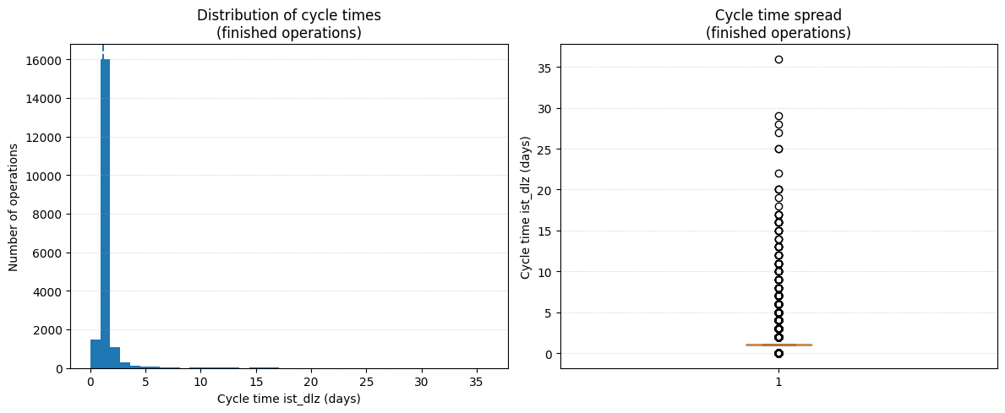
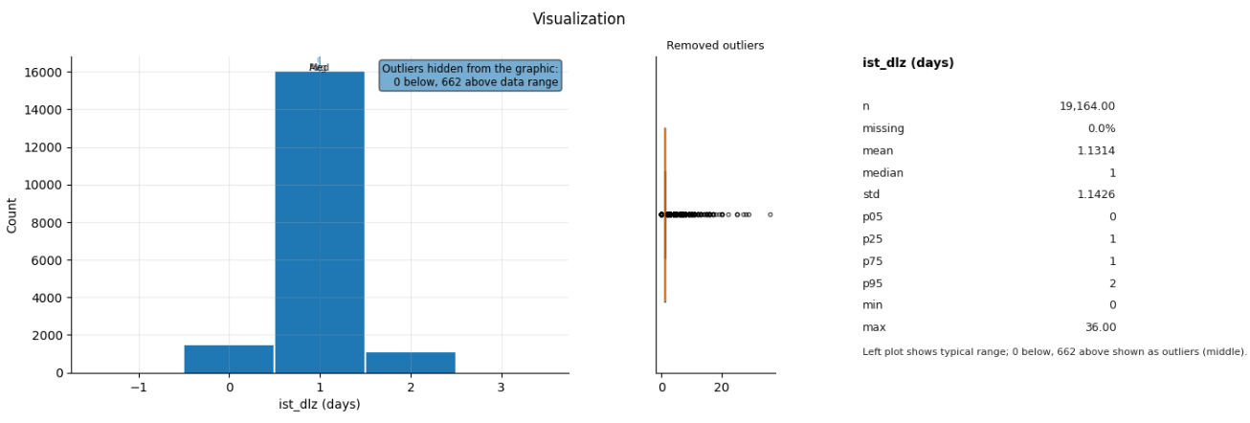
Prompt 2: Display key statistics of cycle times for finished operations.
Metric / Analysis | Evaluation (0 to 3)
Family/type: descriptive, stats summary
Filters: status == fertiggemeldet
Columns: ist_dlz
Prepare: none
Aggregate: none
Verify status: warn (check summary)
Summary: Finished operations average 1.13 days cycle
time. Most complete in 0 to 2 days, some last up to 36
days. High rate of identical cycle times.
perceived_analysis_difficulty | 1
task_choice_quality | 3
data_scope_quality | 3
prep_and_aggregation_quality | 3
summary_quality | 3
visualization_helpfulness | 2
analysis_request_fulfilment | 3
Family/type: descriptive, summary
Filters: ist_ende not missing
Columns: ist_dlz
Prepare: Drop rows with missing ist_dlz
Aggregate: summary stats
Verify status: warn (check summary)
Summary: Finished operations have a mean cycle time of 1.13 days and median 1 day, with most between 1 and 1 day and extremes from 0 to 36 days; a small share of jobs shows very long cycle times.
perceived_analysis_difficulty | 1
task_choice_quality | 2
data_scope_quality | 3
prep_and_aggregation_quality | 3
summary_quality | 3
visualization_helpfulness | 1
analysis_request_fulfilment | 1
Family/type: descriptive, stats summary
Filters: status == fertiggemeldet
Columns: ta_ist_dlz
Prepare: none
Aggregate: none
Verify status: ok
Summary: Generated analysis for: Display key statistics of cycles times for finished operations.
perceived_analysis_difficulty | 1
task_choice_quality | 3
data_scope_quality | 3
prep_and_aggregation_quality | 3
summary_quality | 1
visualization_helpfulness | 2
analysis_request_fulfilment | 3

Slide 6
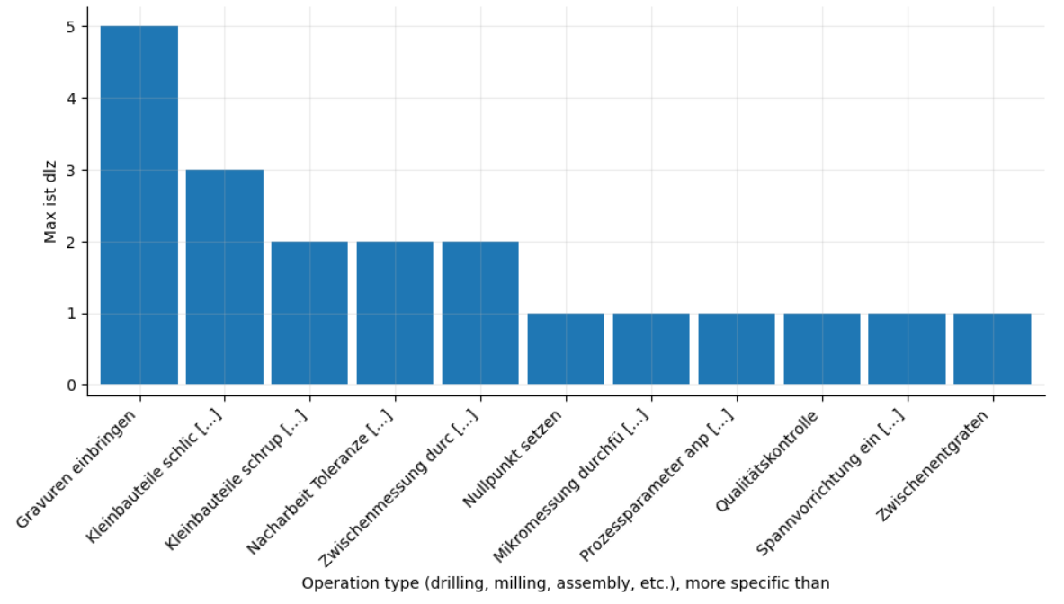
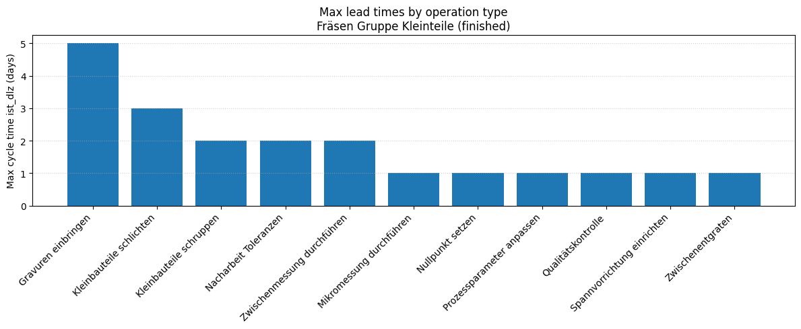
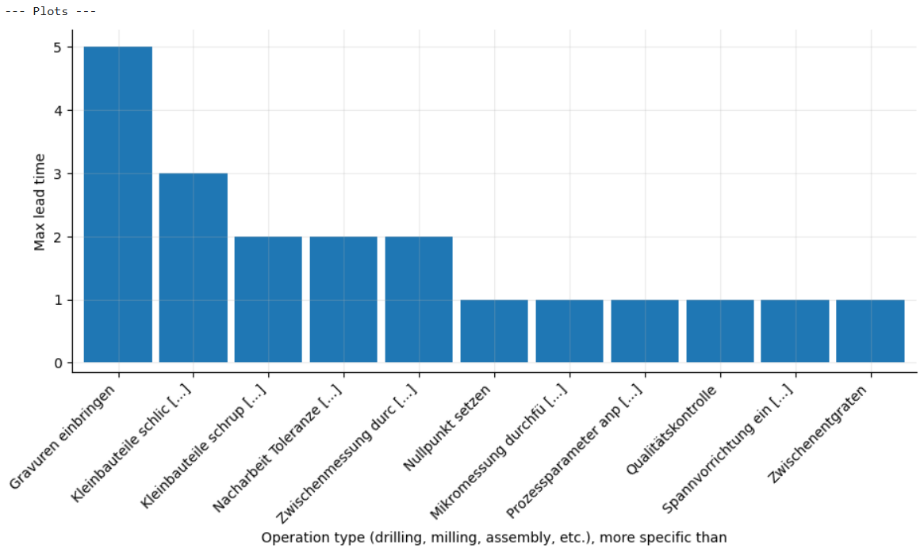
Prompt 3: Compare the max lead times for Fräsen Gruppe Kleinteile by operation type.
Metric / Analysis | Evaluation (0 to 3)
Family/type: descriptive, group compare
Filters: resource_group == Fräsen Gruppe Kleinteile
Columns: avg_type, ist_dlz
Prepare: Clean up text (trim spaces); Convert to numbers (ist_dlz); Remove rows with missing required values
(ist_dlz)
Aggregate: groupby=[avg_type];
metrics=[max_ist_dlz(max:ist_dlz), n_records=count]
Verify status: warn (check summary)
Summary: Comparing max actual cycle days per operation type shows most operations finish in one day. A few types take up to five days. Consider process improvements for slow operations.
perceived_analysis_difficulty | 2
task_choice_quality | 3
data_scope_quality | 3
prep_and_aggregation_quality | 3
summary_quality | 3
visualization_helpfulness | 3
analysis_request_fulfilment | 3
Family/type: descriptive, summary
Filters: resource_group == Fräsen Gruppe Kleinteile; ist_ende not missing
Columns: ist_dlz, avg_type
Prepare: Drop rows with missing ist_dlz or avg_type
Aggregate: max(ist_dlz) by avg_type
Verify status: warn (check summary)
Summary: Max lead times vary between 1 and 5 days, with “Gravuren einbringen” highest (5 days) and most other operation types at or below 2–3 days.
perceived_analysis_difficulty | 2
task_choice_quality | 3
data_scope_quality | 3
prep_and_aggregation_quality | 3
summary_quality | 3
visualization_helpfulness | 3
analysis_request_fulfilment | 3
Family/type: descriptive, group compare
Filters: resource_group == Fräsen Gruppe Kleinteile;
status == fertiggemeldet
Columns: avg_type, ist_dlz
Prepare: none
Aggregate: groupby=[avg_type];
metrics=[max_lead_time(max:ist_dlz), n_records=count]
Verify status: warn (check summary)
Summary: Maximum lead times for Fräsen Gruppe
Kleinteile operations by type varied significantly.
Most types capped at 1 day, but one peaked at 5 days.
Groups with fewer records may skew max lead times.
perceived_analysis_difficulty | 2
task_choice_quality | 3
data_scope_quality | 3
prep_and_aggregation_quality | 3
summary_quality | 2
visualization_helpfulness | 3
analysis_request_fulfilment | 3

Slide 7
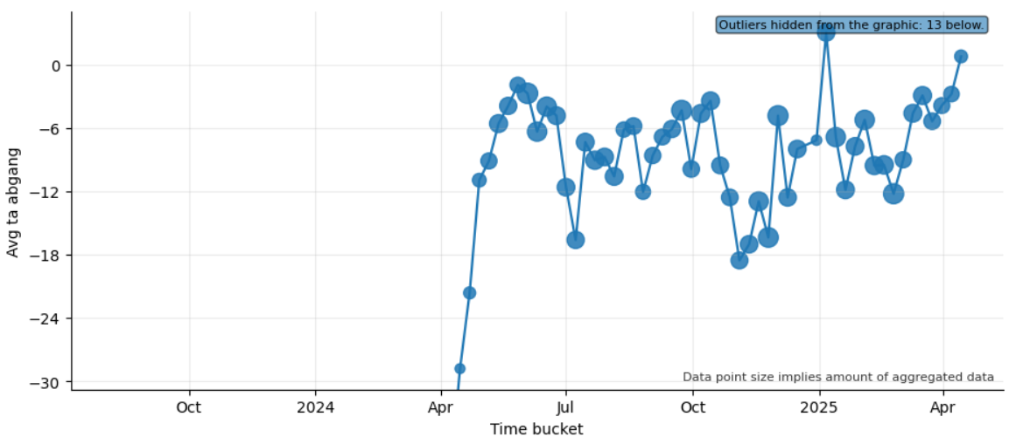
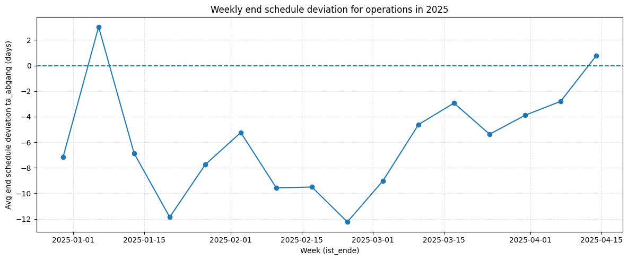
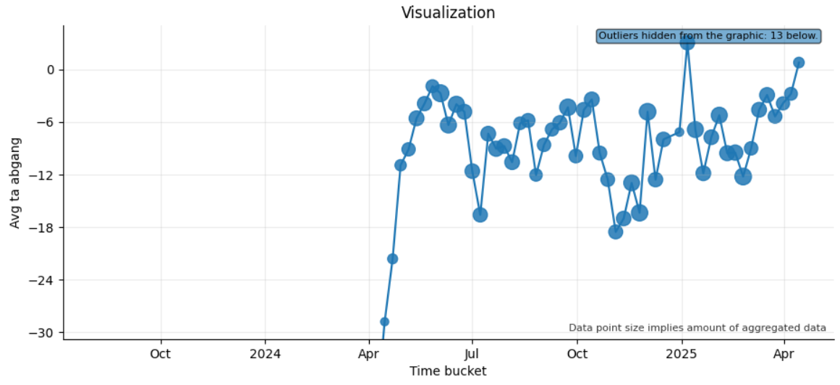
Prompt 4: Show me the trend for weekly end schedule deviations of operations in 2025.
Metric / Analysis | Evaluation (0 to 3)
Family/type: descriptive, trend
Filters: none
Columns: ist_ende, ta_abgang
Prepare: Remove rows with missing required values
(ist_ende, ta_abgang)
Aggregate: time=ist_ende/week;
metrics=[avg_ta_abgang(mean:ta_abgang),
n_records=count]
Verify status: warn (check summary)
Summary: Operations ended on average about 42 days
early, improving from 590 days early in August 2023 to
near on time by April 2025. Typical weekly range: 112 to 3 days early. Most extreme weeks: 613 days early, 3 days late. Review weeks with large early deviations.
perceived_analysis_difficulty | 2
task_choice_quality | 3
data_scope_quality | 1
prep_and_aggregation_quality | 3
summary_quality | 3
visualization_helpfulness | 3
analysis_request_fulfilment | 2
Family/type: descriptive, trend
Filters: ist_ende >= 2025-01-01; ist_ende < 2026-01-01; ta_abgang not missing
Columns: ta_abgang, ist_ende
Prepare: Derive week from ist_ende; drop missing values
Aggregate: mean(ta_abgang) by week
Verify status: warn (check summary)
Summary: Weekly end deviations in 2025 start clearly early (around −10 to −5 days), then gradually improve and approach on-time completion, with recent weeks even slightly late (up to about +1 day).
perceived_analysis_difficulty | 2
task_choice_quality | 3
data_scope_quality | 3
prep_and_aggregation_quality | 3
summary_quality | 3
visualization_helpfulness | 2
analysis_request_fulfilment | 3
Family/type: descriptive, trend
Filters: none
Columns: ist_ende, ta_abgang
Prepare: Remove rows with missing required values
(ist_ende, ta_abgang)
Aggregate: time=ist_ende/week;
metrics=[avg_ta_abgang(mean:ta_abgang),
n_records=count]
Verify status: warn
Summary: Computed monthly average avg_ta_abgang by group (2023-08-07T00:00:00 → 2025-04-14T00:00:00,
65 points; mean≈-42.10; Δend-start≈590.77).
perceived_analysis_difficulty | 2
task_choice_quality | 3
data_scope_quality | 1
prep_and_aggregation_quality | 3
summary_quality | 2
visualization_helpfulness | 3
analysis_request_fulfilment | 2

Slide 8
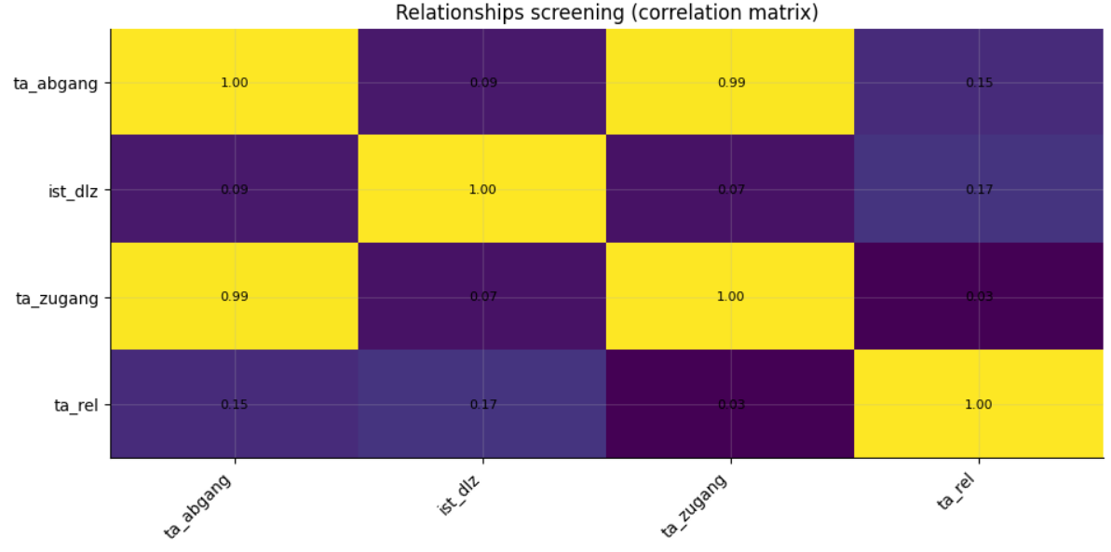
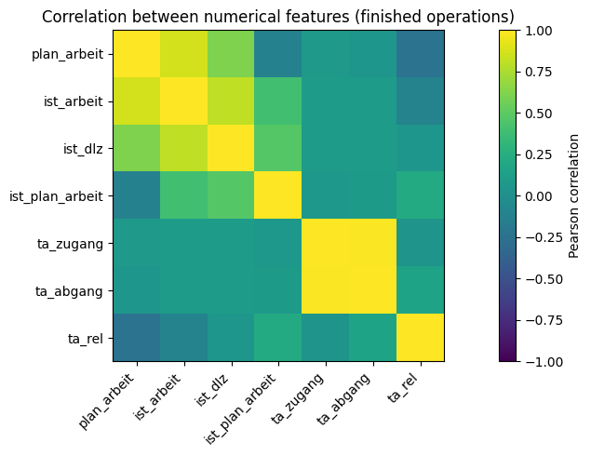
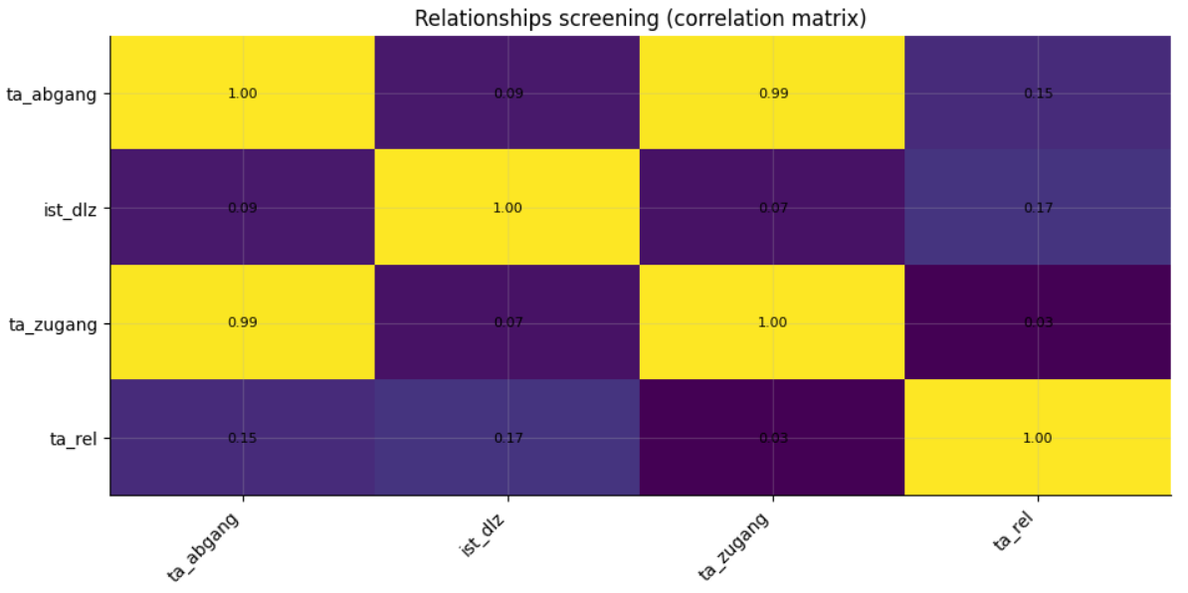
Prompt 5: Show me how the numerical values in the data are related to each other, finished operations only.
Metric / Analysis | Evaluation (0 to 3)
Family/type: descriptive, relationships
Filters: status == fertiggemeldet
Columns: ta_abgang, ist_dlz, ta_zugang, ta_rel
Prepare: none
Aggregate: none
Verify status: warn
Summary: End and start delays track almost one-to-one, while cycle and lead-time deviations are less linked.
Operations finish on average 8 days early, ranging from 50 days early to 19 days late. Lead-time deviation median −1 day (range −6 to +1). Examine causes of large early
finishes.
perceived_analysis_difficulty | 2
task_choice_quality | 3
data_scope_quality | 3
prep_and_aggregation_quality | 3
summary_quality | 2
visualization_helpfulness | 3
analysis_request_fulfilment | 3
Family/type: descriptive, correlation
Filters: ist_ende not missing
Columns: plan_arbeit, ist_arbeit, ist_dlz, ist_plan_arbeit, ta_zugang, ta_abgang, ta_rel
Prepare: Drop rows with missing selected numeric columns
Aggregate: Pearson correlation matrix
Verify status: warn (check summary)
Summary: Planned and actual work correlate strongly (ρ ≈ 0.86), actual work with cycle time even stronger (≈ 0.81), and start/end deviations are almost perfectly aligned (≈ 0.99), while relative deviation ta_rel is only weakly linked to other measures.
perceived_analysis_difficulty | 2
task_choice_quality | 3
data_scope_quality | 2
prep_and_aggregation_quality | 3
summary_quality | 3
visualization_helpfulness | 2
analysis_request_fulfilment | 3
Family/type: descriptive, relationships
Filters: status == fertiggemeldet
Columns: ta_abgang, ist_dlz, ta_zugang, ta_rel
Prepare: none
Aggregate: none
Verify status: warn
Summary: Generated analysis for: Show me how the
numerical values in the data are related to each other,
finished operations only.
perceived_analysis_difficulty | 2
task_choice_quality | 3
data_scope_quality | 3
prep_and_aggregation_quality | 3
summary_quality | 1
visualization_helpfulness | 3
analysis_request_fulfilment | 3

Slide 9
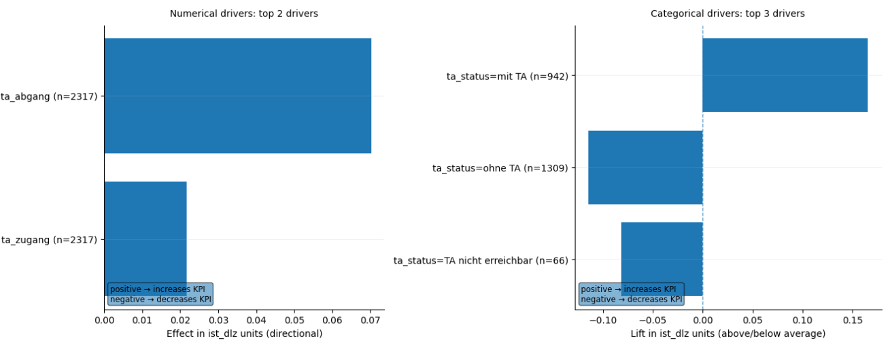
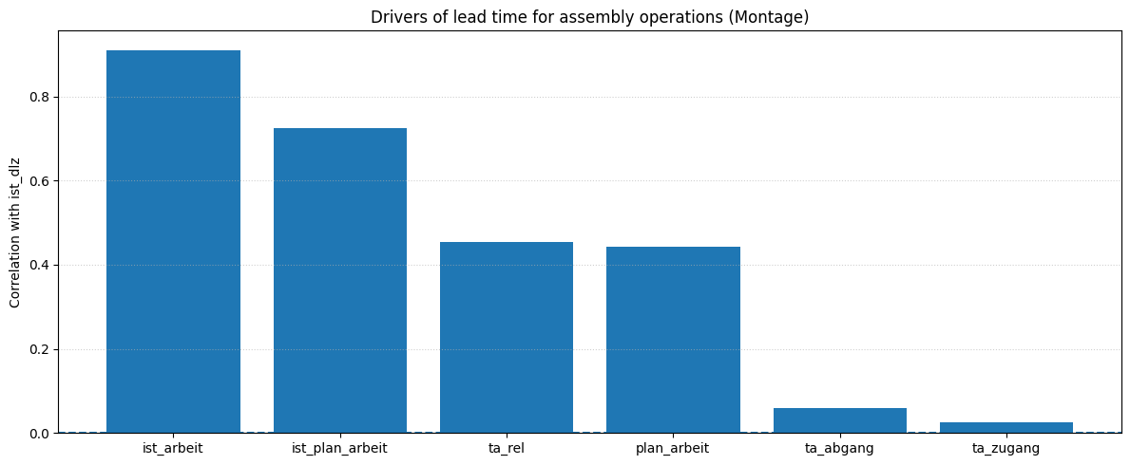
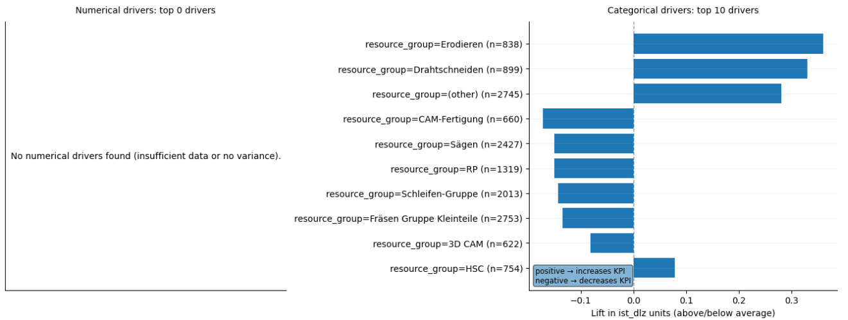
Prompt 6: Which drivers affected lead times for assembly operations?
Metric / Analysis | Evaluation (0 to 3)
Family/type: diagnostic, driver relationships
Filters: resource_group == Montage
Columns: ta_status, ist_dlz, ta_zugang, ta_abgang
Prepare: Standardize missing-value labels; Clean up text
(trim spaces); Fill missing numbers (typical value)
(ist_dlz, ta_abgang)
Aggregate: none
Verify status: warn (check summary)
Summary: Assembly cycle time averages 1.1 days and typically falls between 0–2 days. Start and end timing deviations showed minimal effect on this cycle time. Remove
duplicates and reanalyze deviations effect.
perceived_analysis_difficulty | 3
task_choice_quality | 3
data_scope_quality | 3
prep_and_aggregation_quality | 3
summary_quality | 3
visualization_helpfulness | 3
analysis_request_fulfilment | 3
Family/type: descriptive, correlation
Filters: resource_group == Montage; ist_dlz not missing
Columns: ist_dlz, plan_arbeit, ist_arbeit, ist_plan_arbeit, ta_zugang, ta_abgang, ta_rel
Prepare: Drop rows with missing selected numeric columns
Aggregate: Pearson corr(ist_dlz, ·)
Verify status: warn (check summary)
Summary: Assembly lead times are mainly driven by actual work ist_arbeit (ρ ≈ 0.91) and planned work/relative deviation (ist_plan_arbeit, ta_rel, plan_arbeit, ρ ≈ 0.44–0.72), while start/end schedule deviations have only minor impact.
perceived_analysis_difficulty | 3
task_choice_quality | 2
data_scope_quality | 3
prep_and_aggregation_quality | 3
summary_quality | 3
visualization_helpfulness | 2
analysis_request_fulfilment | 2
Family/type: diagnostic, driver relationships
Filters: none
Columns: resource_group, plan_start, ist_start,
plan_ende, ist_dlz
Prepare: none
Aggregate: none
Verify status: warn
Summary: Generated analysis for: Which drivers affected lead times for assembly operations?.
perceived_analysis_difficulty | 3
task_choice_quality | 3
data_scope_quality | 1
prep_and_aggregation_quality | 3
summary_quality | 1
visualization_helpfulness | 2
analysis_request_fulfilment | 1

Slide 10
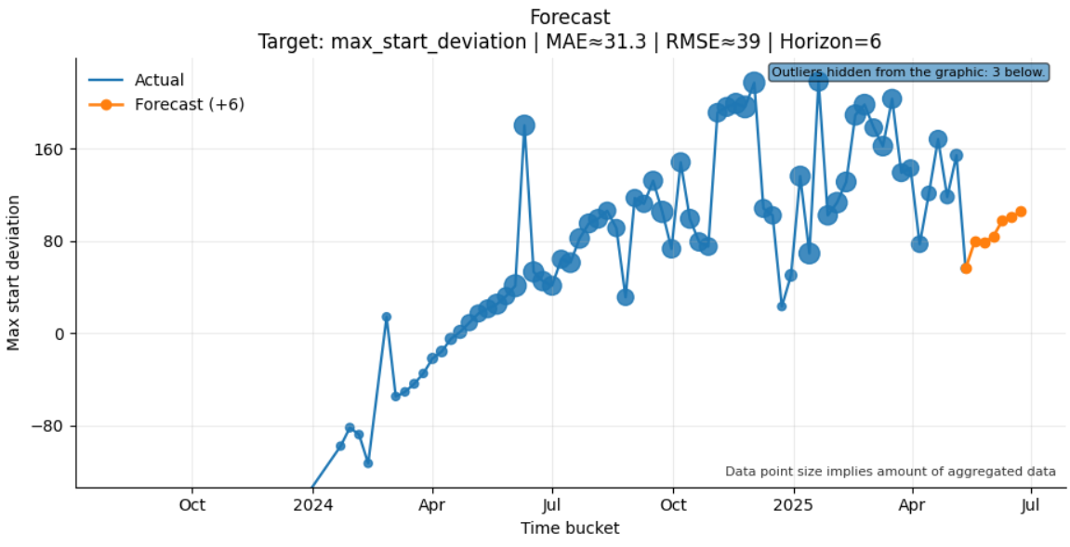
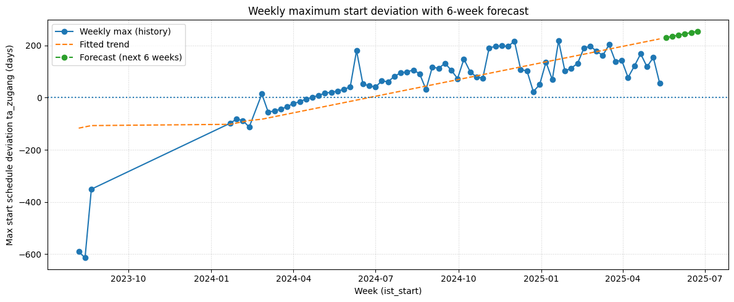

Prompt 7: Show me how the maximum start deviation will change for the next 6 weeks.
Metric / Analysis | Evaluation (0 to 3)
Family/type: predictive, forecasting
Filters: none
Columns: ist_start, ta_zugang
Prepare: Convert to dates/times (ist_start)
Aggregate: time=ist_start/week;
metrics=[max_start_deviation(max:ta_zugang),
n_records=count]
Verify status: warn (check summary)
Summary: The forecasted weekly maximum start delay
averages around 54 days. Most weeks fall between –106
and 199 days delay, with extremes from –614 to 218
days. Plan capacity around 54 days of delay.
perceived_analysis_difficulty | 2
task_choice_quality | 3
data_scope_quality | 3
prep_and_aggregation_quality | 3
summary_quality | 3
visualization_helpfulness | 3
analysis_request_fulfilment | 3
Family/type: predictive, time series
Filters: ist_start not missing; ta_zugang not missing
Columns: ta_zugang, ist_start
Prepare: Derive week from ist_start; aggregate to weekly max
Aggregate: max(ta_zugang) by week; linear trend forecast next 6 weeks
Verify status: warn (simple linear forecast, no intervals)
Summary: The model projects weekly maximum start deviation to rise from about +230 to roughly +255 days late over the next 6 weeks, continuing the strong upward trend in extreme late starts.
perceived_analysis_difficulty | 2
task_choice_quality | 3
data_scope_quality | 3
prep_and_aggregation_quality | 3
summary_quality | 3
visualization_helpfulness | 1
analysis_request_fulfilment | 1
Family/type: predictive, forecasting
Filters: none
Columns: ist_start, ta_zugang
Prepare: none
Aggregate: time=ist_start/week;
metrics=[max_start_deviation(max:ta_zugang),
n_records=count]
Verify status: warn (check summary)
Summary: Generated analysis for: Show me how the
maximum start deviation will change for the next 6
weeks.
perceived_analysis_difficulty | 2
task_choice_quality | 3
data_scope_quality | 3
prep_and_aggregation_quality | 3
summary_quality | 1
visualization_helpfulness | 3
analysis_request_fulfilment | 3

Slide 11
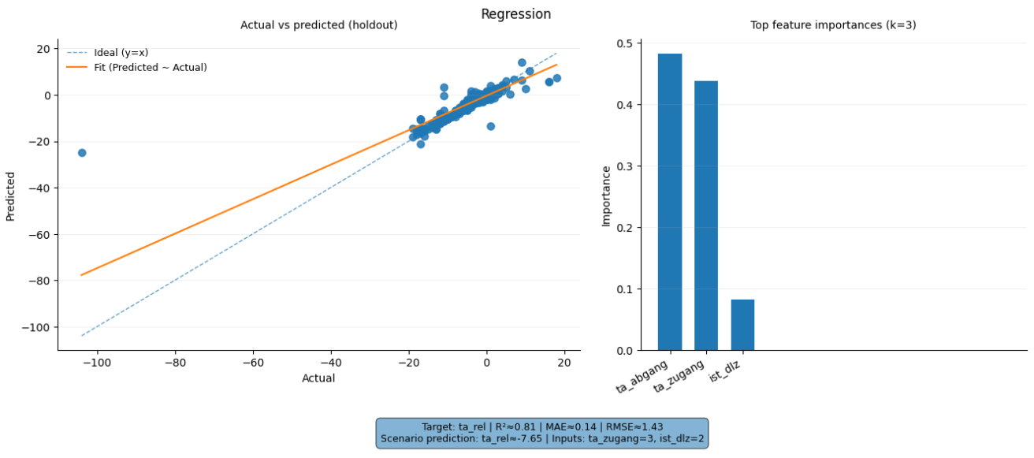
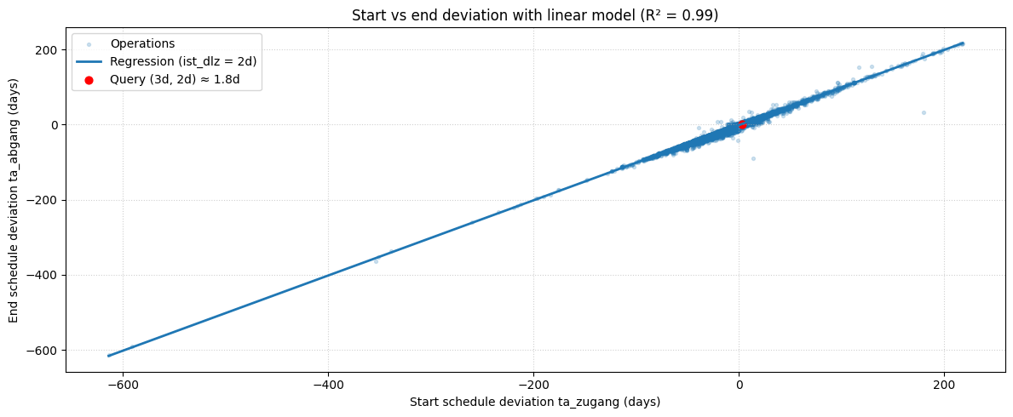

Prompt 8: If start deviation is 3 days and cycle time is 2 days, what would be a good prediction for the end deviation?
Metric / Analysis | Evaluation (0 to 3)
Family/type: predictive, regression
Filters: none
Columns: ta_rel, ta_zugang, ist_dlz, ta_abgang
Prepare: Remove rows with missing required values
(ta_abgang); Convert to numbers (ta_rel, ta_zugang,
ist_dlz (+1))
Aggregate: none
Verify status: warn (check summary)
Summary: A 3-day late start with a 2-day cycle time
predicts about a 1.5-day end delay. Typical end deviation
range: -3 to +4 days. Predicted end delay ~1.4 days late.
Check specific operation types for accuracy.
perceived_analysis_difficulty | 2
task_choice_quality | 3
data_scope_quality | 3
prep_and_aggregation_quality | 3
summary_quality | 3
visualization_helpfulness | 2
analysis_request_fulfilment | 3
Family/type: predictive, regression
Filters: ta_zugang, ist_dlz, ta_abgang not missing
Columns: ta_abgang (target), ta_zugang, ist_dlz
Prepare: Drop rows with missing ta_zugang, ist_dlz, ta_abgang
Aggregate: Linear regression ta_abgang ~ ta_zugang + ist_dlz
Verify status: warn (simple linear model, R² ≈ 0.99)
Summary: For a start deviation of 3 days and cycle time of 2 days, the model predicts an end-date deviation of about +1.8 days (roughly 2 days late)
perceived_analysis_difficulty | 2
task_choice_quality | 3
data_scope_quality | 3
prep_and_aggregation_quality | 3
summary_quality | 3
visualization_helpfulness | 2
analysis_request_fulfilment | 2
Family/type: predictive, regression
Filters: none
Columns: ta_rel, ta_zugang, ist_dlz, ta_abgang
Prepare: none
Aggregate: none
Verify status: warn (check summary)
Summary: The end deviation is predicted to be 2 days.
This estimate adds the typical lead-time deviation of -1
day to the start deviation of 3 days. Weak link between
cycle time and deviation observed. Historical median lead-time deviation is -1 day. Prediction may not hold for long
cycle times without segmentation.
perceived_analysis_difficulty | 2
task_choice_quality | 3
data_scope_quality | 3
prep_and_aggregation_quality | 3
summary_quality | 3
visualization_helpfulness | 2
analysis_request_fulfilment | 3

Slide 12
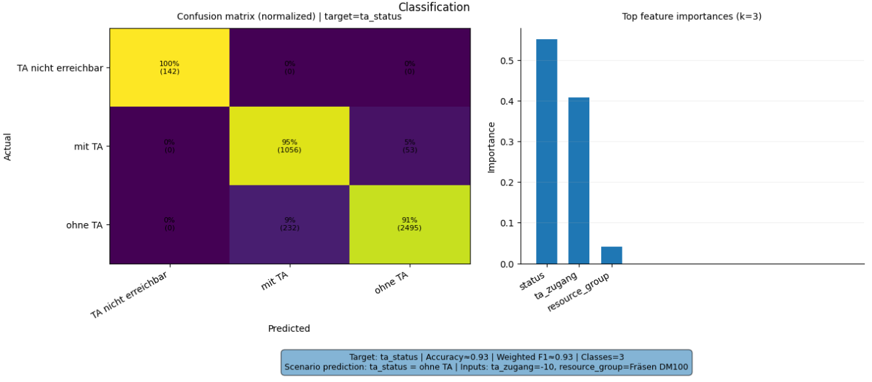
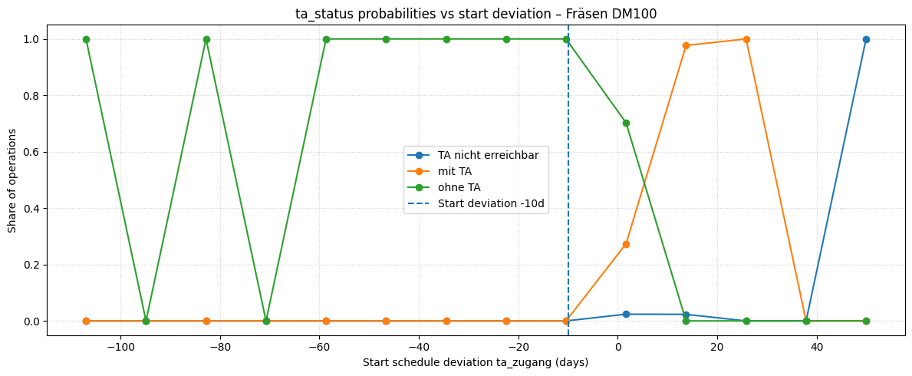
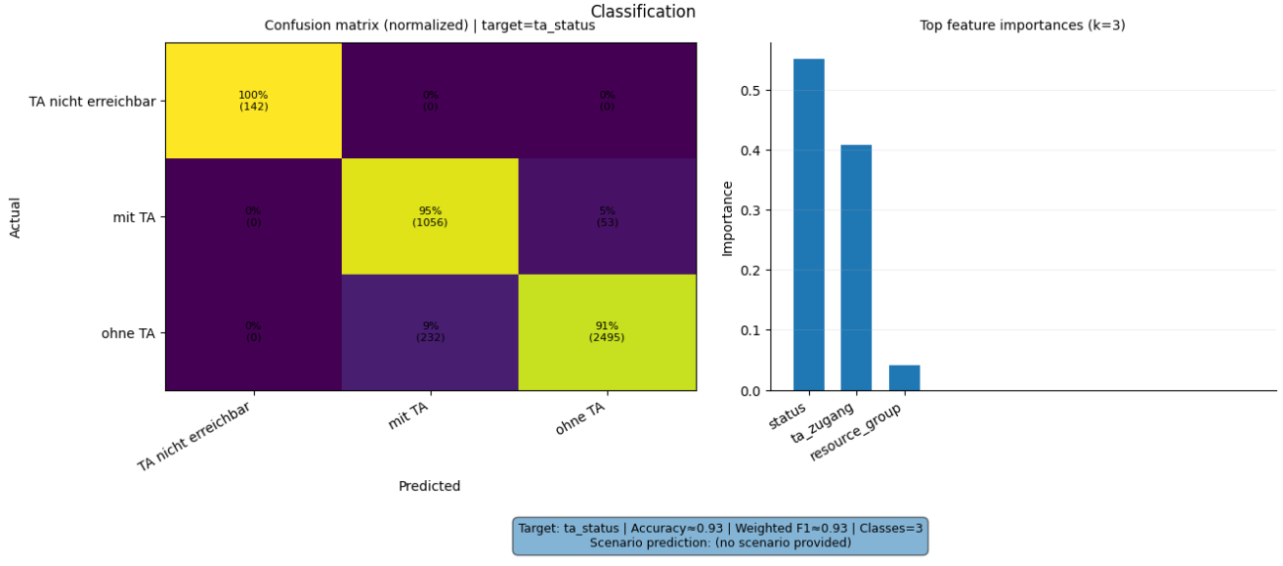
Prompt 9: Classify the likely ta_status if start is 10 days early and resource group ‘Fräsen DM100’.
Metric / Analysis | Evaluation (0 to 3)
Family/type: predictive, classification
Filters: none
Columns: status, ta_status, resource_group, ta_zugang
Prepare: Standardize missing-value labels; Clean up text
(trim spaces); Convert to numbers (ta_zugang)
Aggregate: none
Verify status: warn (check summary)
Summary: For a start 10 days early in 'Fräsen DM100', the model predicts no schedule deviation ('ohne TA'). Typical deviation ranges from –47 to +20 days. Average start
deviation is –6.25 days. Resource group 'Fräsen DM100' missing in training data.
perceived_analysis_difficulty | 2
task_choice_quality | 3
data_scope_quality | 3
prep_and_aggregation_quality | 3
summary_quality | 3
visualization_helpfulness | 2
analysis_request_fulfilment | 3
Family/type: predictive, classification
Filters: resource_group == Fräsen DM100; ta_status, ta_zugang not missing
Columns: ta_status, ta_zugang
Prepare: Restrict to Fräsen DM100 and drop missing values
Aggregate: Empirical class frequencies by ta_zugang bins
Verify status: warn (empirical, no model)
Summary: For Fräsen DM100 operations starting ≈10 days early (ta_zugang ≈ −10), historical data shows 100 % of cases labeled ta_status = "ohne TA", so this is the clearly likely status.
perceived_analysis_difficulty | 2
task_choice_quality | 3
data_scope_quality | 2
prep_and_aggregation_quality | 3
summary_quality | 3
visualization_helpfulness | 1
analysis_request_fulfilment | 3
Family/type: predictive, classification
Filters: none
Columns: status, ta_status, resource_group, ta_zugang
Prepare: Standardize missing-value labels; Clean up text (trim spaces)
Aggregate: none
Verify status: warn (check summary)
Summary: Unable to classify ta_status because 'Fräsen
DM100' resource group isn't in the data. Operations
typically start 6 days early on average. 68% of operations
finish as planned with no delays. Missing Fräsen DM100
group impacts classification.
perceived_analysis_difficulty | 2
task_choice_quality | 3
data_scope_quality | 3
prep_and_aggregation_quality | 3
summary_quality | 1
visualization_helpfulness | 2
analysis_request_fulfilment | 2

Slide 13
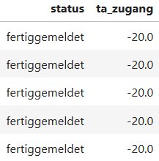
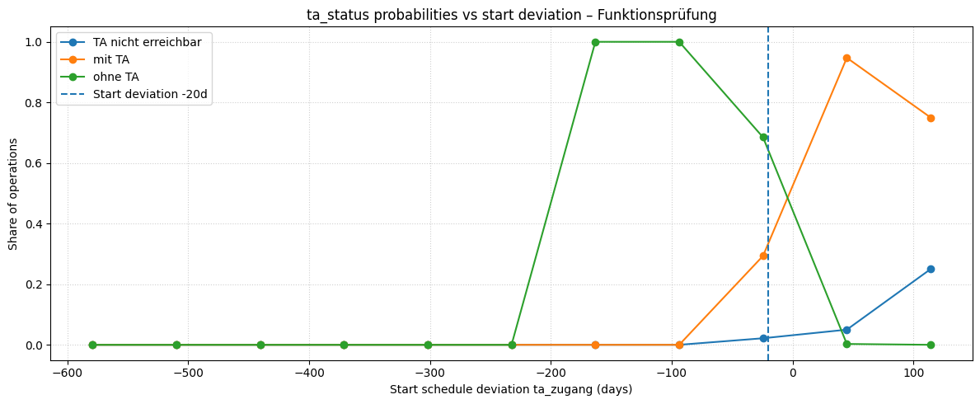
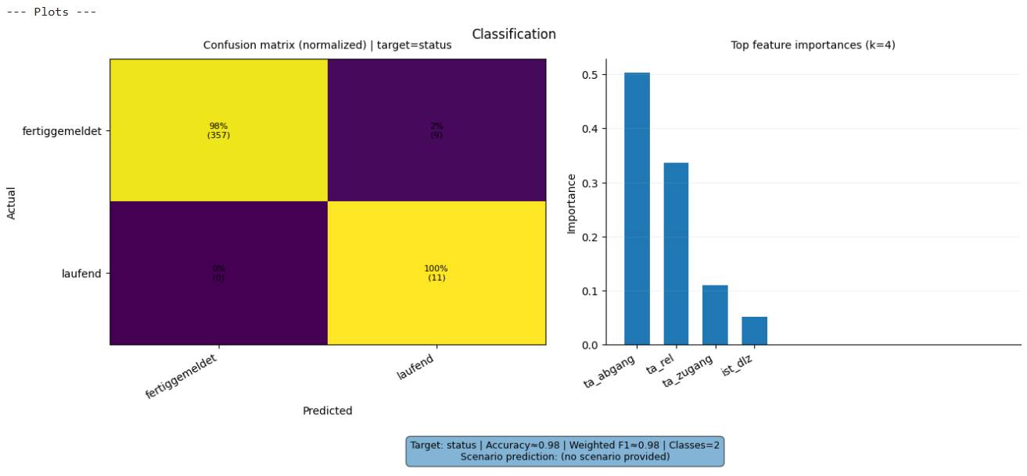
Prompt 10: Classify a likely ta status in a situation where the operation startet 20 days early with a 'Funktionsprüfung’.
Metric / Analysis | Evaluation (0 to 3)
Metric / Analysis | Evaluation (0 to 3)
Family/type: predictive, classification
Filters: avg_type == Funktionsprüfung; ta_zugang == -20
Columns: status, ta_zugang
Prepare: Standardize missing-value labels; Clean up text
(trim spaces); Convert to numbers (ta_zugang)
Aggregate: none
Verify status: warn (check summary)
Summary: When Funktionsprüfung started 20 days
before plan, all operations were marked finished.
11 operations met these criteria. Explore other early start intervals.
perceived_analysis_difficulty | 3
task_choice_quality | 3
data_scope_quality | 2
prep_and_aggregation_quality | 3
summary_quality | 2
visualization_helpfulness | 1
analysis_request_fulfilment | 2
View all
Family/type: predictive, classification
Filters: avg_type == Funktionsprüfung; ta_zugang not missing; ta_status not missing
Columns: ta_status, ta_zugang
Prepare: Focus on cases with −30 ≤ ta_zugang ≤ −10
Aggregate: ta_status frequency and share in that ta_zugang band
Verify status: warn (empirical probability only)
Summary: For Funktionsprüfung starting ~20 days early, about 99 % of historical cases are ohne TA and ~1 % mit TA, so ta_status = "ohne TA" is the clearly expected status.
perceived_analysis_difficulty | 3
task_choice_quality | 3
data_scope_quality | 1
prep_and_aggregation_quality | 2
summary_quality | 3
visualization_helpfulness | 1
analysis_request_fulfilment | 2
Family/type: predictive, classification
Filters: avg_type == Funktionsprüfung; ta_zugang == -20
Columns: status, ta_zugang, ta_abgang, ta_rel
Prepare: none
Aggregate: none
Verify status: warn (check summary)
Summary: Generated analysis for: Classify a likely ta
status in a situation where the operation startet 20 days
early with a 'Funktionsprüfung'.
perceived_analysis_difficulty | 3
task_choice_quality | 2
data_scope_quality | 2
prep_and_aggregation_quality | 3
summary_quality | 1
visualization_helpfulness | 2
analysis_request_fulfilment | 2

Slide 14
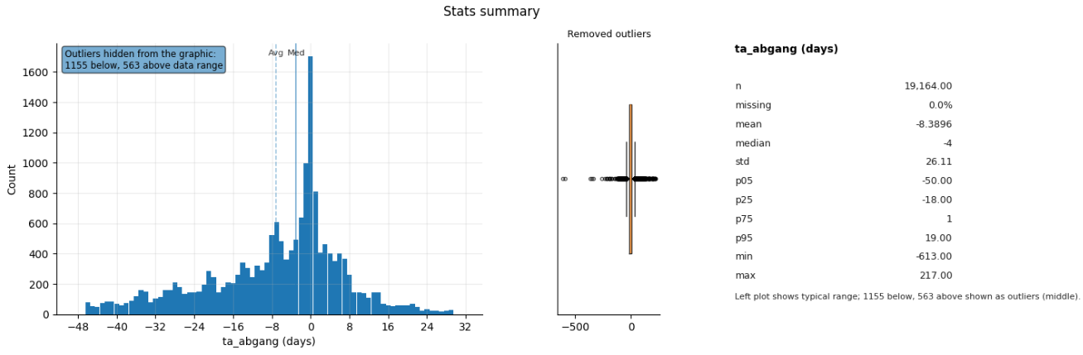
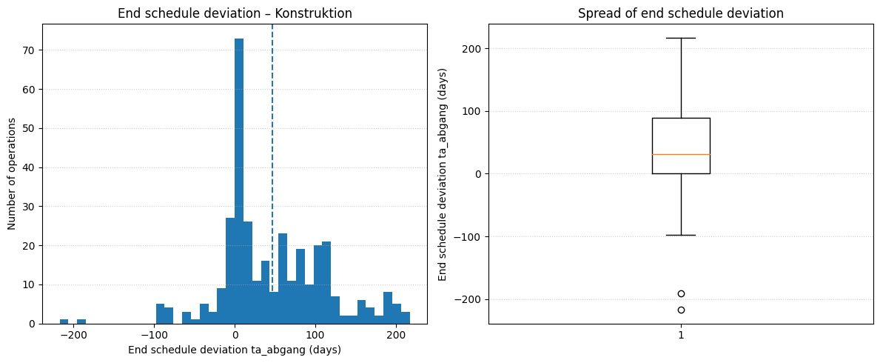
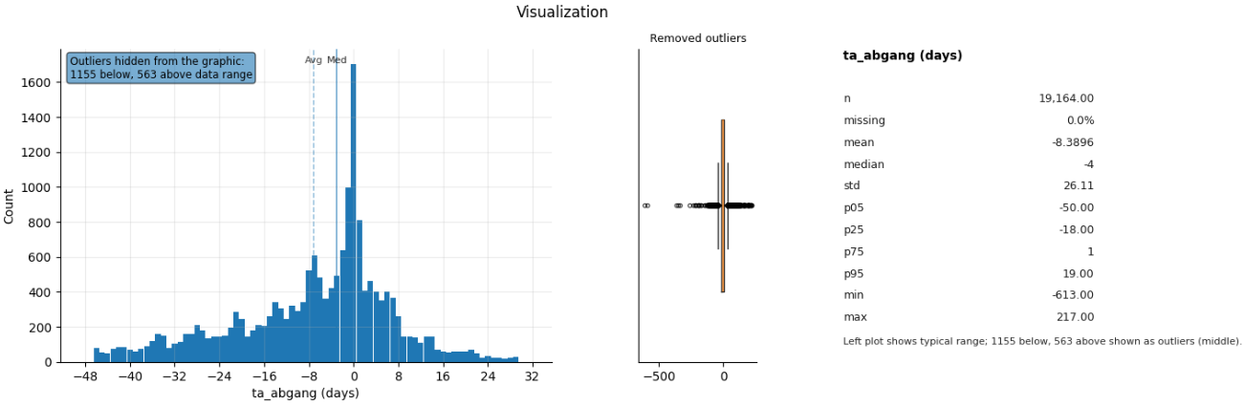
Prompt 11: For Konstruktion operations, what are the main statistics about the end schedule deviation?
Metric / Analysis | Evaluation (0 to 3)
Family/type: descriptive, summary
Filters: none
Columns: ta_abgang
Prepare: Remove rows with missing required values
(ta_abgang)
Aggregate: none
Verify status: warn (check summary)
Summary: Operations finish on average eight days early, with most between fifty days early and nineteen days
late. Some cases span up to six hundred thirteen days
early or two hundred seventeen days late. No filter for
Konstruktion operations applied.
perceived_analysis_difficulty | 1
task_choice_quality | 3
data_scope_quality | 1
prep_and_aggregation_quality | 3
summary_quality | 2
visualization_helpfulness | 3
analysis_request_fulfilment | 1
Family/type: descriptive, summary
Filters: resource_group == Konstruktion; ta_abgang not missing
Columns: ta_abgang
Prepare: Drop rows with missing ta_abgang
Aggregate: summary stats (mean, median, percentiles)
Verify status: warn (check summary)
Summary: Konstruktion operations have an average end deviation of about +46 days (median +32 days), with most between −8 and +129 days and extremes from −217 up to +217 days; strong right-skew and very large late finishes.
perceived_analysis_difficulty | 1
task_choice_quality | 3
data_scope_quality | 3
prep_and_aggregation_quality | 3
summary_quality | 3
visualization_helpfulness | 3
analysis_request_fulfilment | 3
Family/type: descriptive, stats_summary
Filters: none
Columns: ta_abgang
Prepare: Remove rows with missing required values
(ta_abgang)
Aggregate: none
Verify status: warn (check summary)
Summary: Operations finished about 8 days early on
average. Typical deviations range from 50 days early to 19 days late. Extreme cases: 613 days early to 217 days late. Cannot filter to Konstruktion operations: missing group
data.
perceived_analysis_difficulty | 1
task_choice_quality | 3
data_scope_quality | 1
prep_and_aggregation_quality | 3
summary_quality | 2
visualization_helpfulness | 3
analysis_request_fulfilment | 1

Slide 15
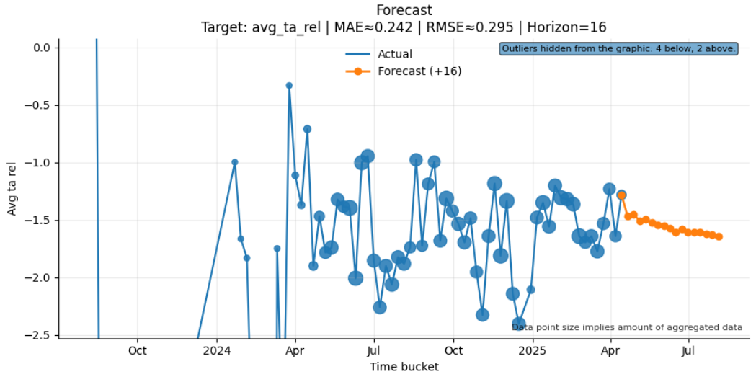
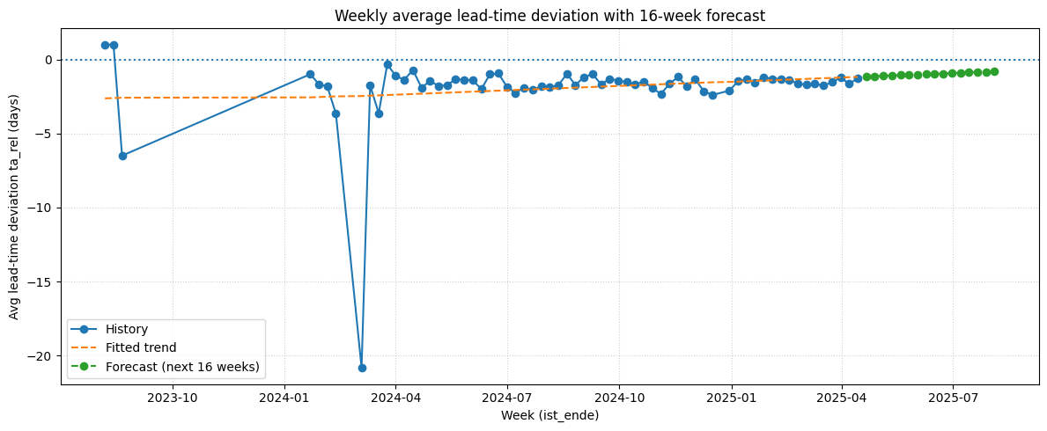
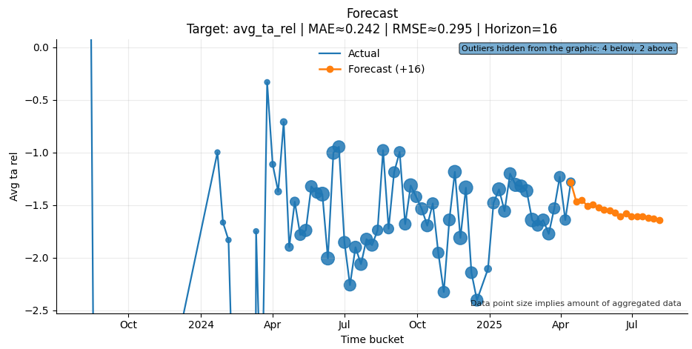
Prompt 12: Forecast the next 16 weeks of weekly average Lead-time deviation.
Metric / Analysis | Evaluation (0 to 3)
Family/type: predictive, forecasting
Filters: status == fertiggemeldet
Columns: ist_ende, ta_rel
Prepare: none
Aggregate: time=ist_ende/week;
metrics=[avg_ta_rel(mean:ta_rel), n_records=count]
Verify status: warn (check summary)
Summary: The forecast predicts weekly average lead-time deviation will stay near the historical mean of -1.9 days
over the next 16 weeks. Usual range between -3.4 and
-0.8 days. Update model if actuals diverge.
perceived_analysis_difficulty | 2
task_choice_quality | 3
data_scope_quality | 3
prep_and_aggregation_quality | 3
summary_quality | 2
visualization_helpfulness | 3
analysis_request_fulfilment | 3
Family/type: predictive, time series
Filters: ist_ende not missing; ta_rel (lead-time deviation) not missing
Columns: ta_rel, ist_ende
Prepare: Derive week from ist_ende; drop missing values
Aggregate: mean(ta_rel) by week; linear trend forecast next 16 weeks
Verify status: warn (simple linear forecast, no intervals)
Summary: The model projects weekly average lead-time deviation to slowly improve from about −1.2 days to roughly −0.8 days over the next 16 weeks, i.e. operations remain slightly faster than planned with a mild trend toward on-time lead times.
perceived_analysis_difficulty | 2
task_choice_quality | 3
data_scope_quality | 3
prep_and_aggregation_quality | 3
summary_quality | 3
visualization_helpfulness | 3
analysis_request_fulfilment | 2
Family/type: predictive, forecasting
Filters: status == fertiggemeldet
Columns: ist_ende, ta_rel, ist_dlz, ta_zugang, ta_abgang
Prepare: Standardize missing-value labels
Aggregate: time=ist_ende/week;
metrics=[avg_ta_rel(mean:ta_rel), n_records=count]
Verify status: warn (check summary)
Summary: We forecasted the next 16 weeks using
historical lead-time deviation data. Operations usually
finish faster than planned. Deviation ranges between 3
days early and 0.8 days early. Typical weekly deviation:
around 1.6 days faster than planned. Some weeks had
very few operations recorded (down to 1).
perceived_analysis_difficulty | 2
task_choice_quality | 3
data_scope_quality | 3
prep_and_aggregation_quality | 3
summary_quality | 2
visualization_helpfulness | 3
analysis_request_fulfilment | 3

Slide 16
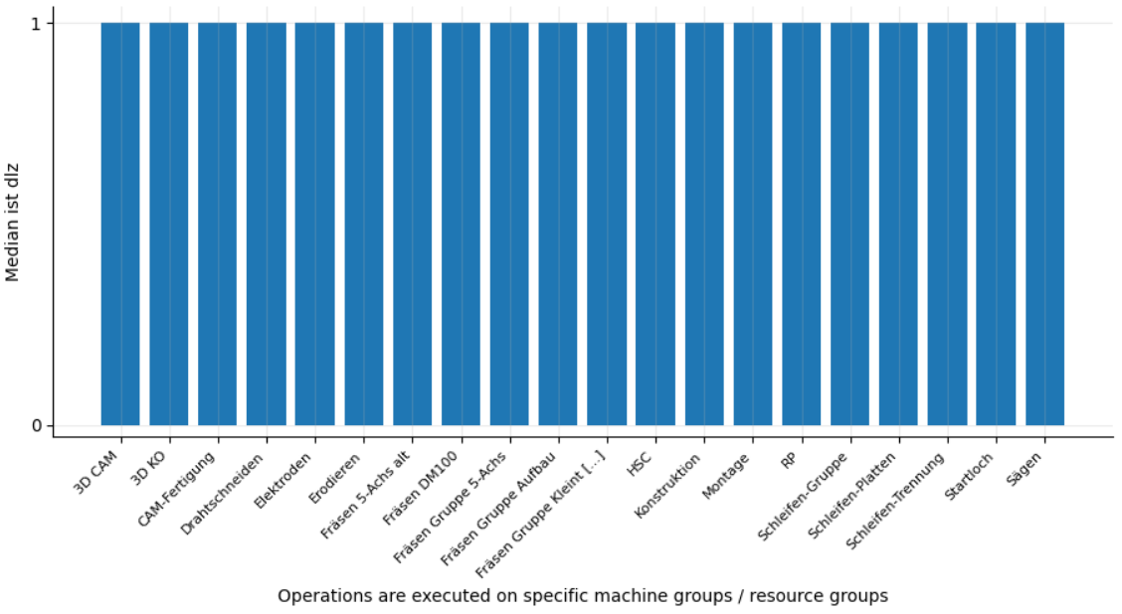
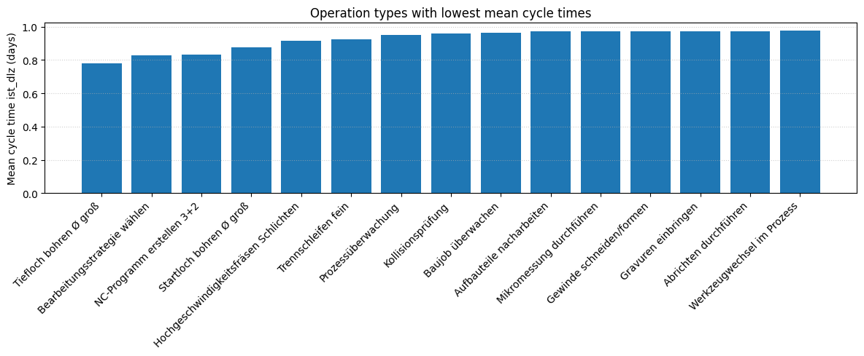
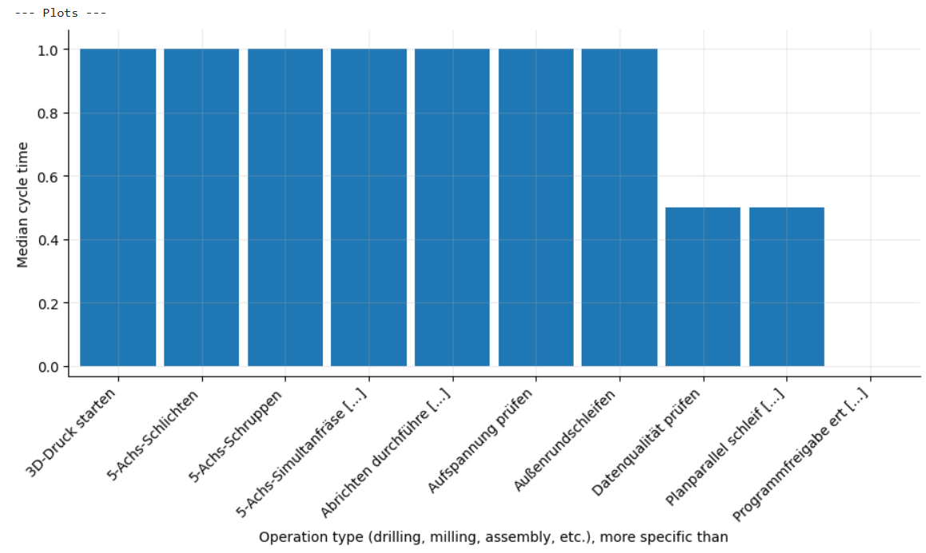
Prompt 13: Which operation type would be best for low cycle times?
Metric / Analysis | Evaluation (0 to 3)
Family/type: prescriptive, candidate_ranking
Filters: status == fertiggemeldet
Columns: resource_group, ta_abgang
Prepare: Clean up text (trim spaces);
Standardize missing-value labels
Aggregate: none
Verify status: warn
Summary: We examined end deviations of finished
operations but did not rank resource groups. Group
averages need to be computed to identify the best group. Typical deviation: 4 days early. Extremes: up to 50 days
early or 19 days late.
perceived_analysis_difficulty | 2
task_choice_quality | 3
data_scope_quality | 3
prep_and_aggregation_quality | 3
summary_quality | 1
visualization_helpfulness | 1
analysis_request_fulfilment | 1
Family/type: descriptive, summary
Filters: ist_dlz not missing; avg_type not missing; count(avg_type) ≥ 30
Columns: ist_dlz, avg_type
Prepare: Drop rows with missing ist_dlz or avg_type; filter to operation types with ≥ 30 observations
Aggregate: mean(ist_dlz), count by avg_type
Verify status: warn (small differences, check counts)
Summary: Among sufficiently frequent types, the lowest mean cycle times are for „Tiefloch bohren Ø groß“ (~0.78 d), „Bearbeitungsstrategie wählen“ (~0.83 d), „NC-Programm erstellen 3+2“ (~0.83 d) and „Startloch bohren Ø groß“ (~0.88 d); these are the best candidates when prioritizing very short cycle times.
perceived_analysis_difficulty | 2
task_choice_quality | 2
data_scope_quality | 3
prep_and_aggregation_quality | 3
summary_quality | 3
visualization_helpfulness | 2
analysis_request_fulfilment | 2
Family/type: descriptive, group_compare
Filters: none
Columns: avg_type, ist_dlz
Prepare: none
Aggregate: groupby=[avg_type];
metrics=[median_cycle_time(median:ist_dlz),
n_records=count]
Verify status: warn
Summary: Generated analysis for: Which operation type would be best for low cycle times?.
perceived_analysis_difficulty | 2
task_choice_quality | 2
data_scope_quality | 3
prep_and_aggregation_quality | 3
summary_quality | 1
visualization_helpfulness | 2
analysis_request_fulfilment | 2

Slide 17
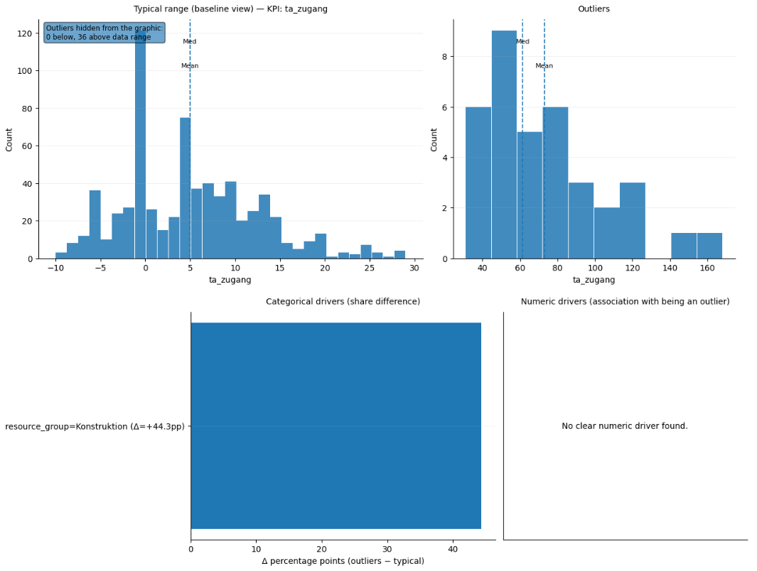
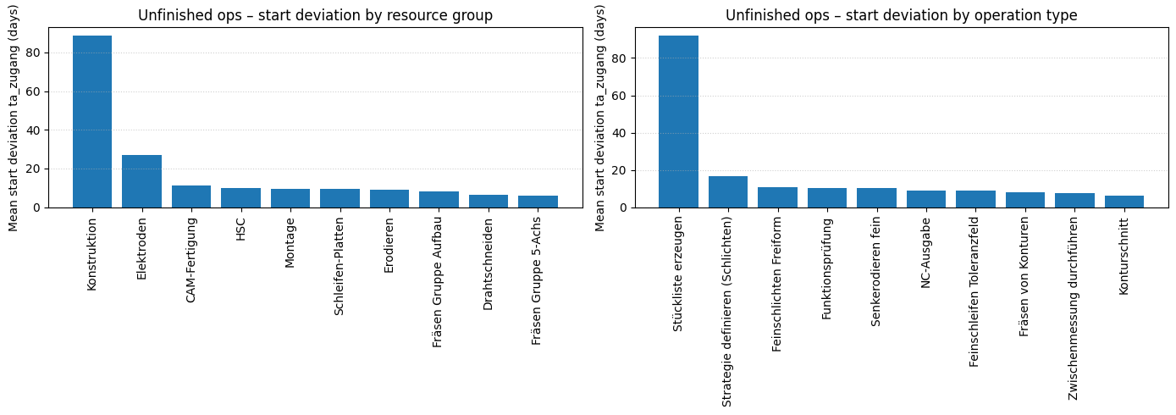

Prompt 14: For unfinshed operations: I want to decrease start deviation. What do I need to work on?
Metric / Analysis | Evaluation (0 to 3)
Family/type: diagnostic, anomaly_explanation
Filters: status == laufend
Columns: resource_group, avg_type, ta_zugang
Prepare: Standardize missing-value labels;
Clean up text (trim spaces)
Aggregate: none
Verify status: warn (check summary)
Summary: Unfinished operations start on average 8 days
late, with most starting between 5 days early and 29 days late. Reducing extreme delays should improve overall
punctuality. Some operations delayed up to 168 days.
Review operations delayed over 29 days.
perceived_analysis_difficulty | 3
task_choice_quality | 1
data_scope_quality | 2
prep_and_aggregation_quality | 3
summary_quality | 3
visualization_helpfulness | 2
analysis_request_fulfilment | 1
Family/type: descriptive, decision support
Filters: ist_ende missing; ta_zugang not missing
Columns: ta_zugang, resource_group, avg_type
Prepare: Drop rows with missing ta_zugang/resource_group/avg_type; restrict to groups/types with ≥10 unfinished ops
Aggregate: mean(ta_zugang) by resource_group and by avg_type
Verify status: warn (unfinished set only)
Summary: For unfinished operations the largest start delays come from Konstruktion (~+89 d) and, at a lower level, Elektroden, CAM-Fertigung, HSC, Montage (~+10–27 d); focusing planning and release control there will cut start deviation most.
perceived_analysis_difficulty | 3
task_choice_quality | 2
data_scope_quality | 2
prep_and_aggregation_quality | 2
summary_quality | 2
visualization_helpfulness | 2
analysis_request_fulfilment | 1
Family/type: diagnostic, anomaly_explanation
Filters: status == laufend
Columns: resource_group, avg_type, ta_zugang
Prepare: Standardize missing-value labels;
Clean up text (trim spaces)
Aggregate: none
Verify status: warn
Summary: Generated analysis for: For unfinshed
operations: I want to decrease start deviation. What do I need to work on?.
perceived_analysis_difficulty | 3
task_choice_quality | 1
data_scope_quality | 2
prep_and_aggregation_quality | 3
summary_quality | 1
visualization_helpfulness | 2
analysis_request_fulfilment | 1

Slide 18
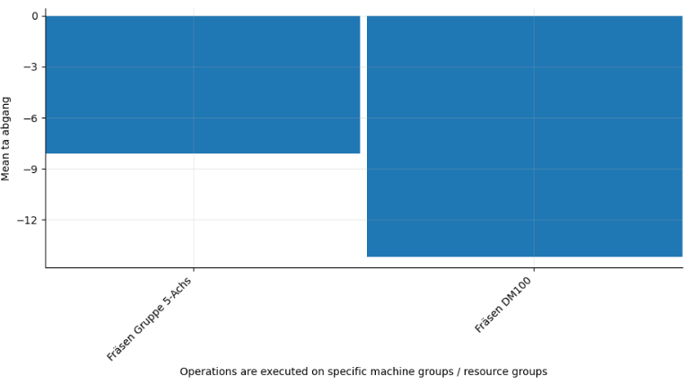
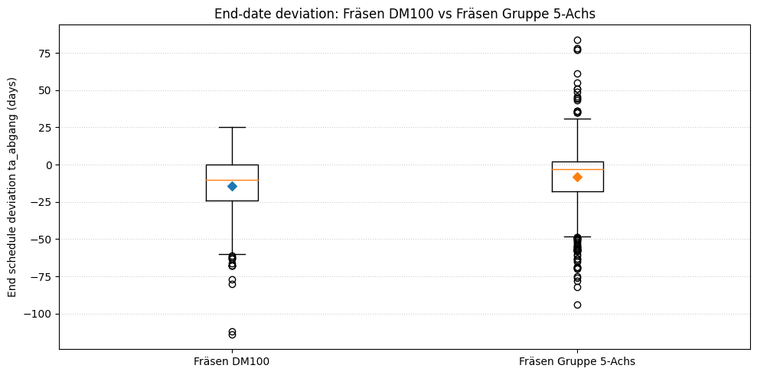
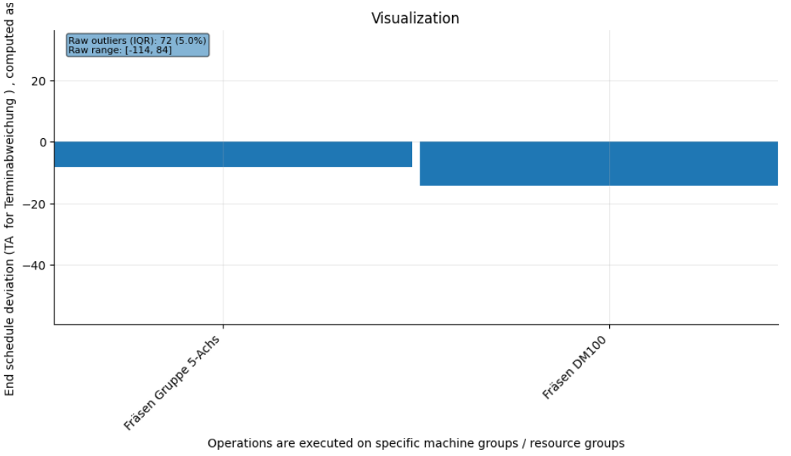
Prompt 15: What happens to expected end-date deviation if we route work to 'Fräsen Gruppe 5-Achs' instead of ‘Fräsen DM100’?
Metric / Analysis | Evaluation (0 to 3)
Family/type: descriptive, group_compare
Filters: resource_group in ['Fräsen Gruppe 5-Achs‘,
'Fräsen DM100']
Columns: resource_group, ta_abgang
Prepare: Clean up text (trim spaces);
Remove rows with missing required values (ta_abgang)
Aggregate: groupby=[resource_group];
metrics=[mean_ta_abgang(mean:ta_abgang), n_records=count]
Verify status: ok
Summary: Routing work to Fräsen Gruppe 5-Achs leads to about 14 days early finish on average, compared to 8 days early on
Fräsen DM100. This switch speeds completion by around 6 days. Evaluate capacity impact of shift to Gruppe 5-Achs.
perceived_analysis_difficulty | 2
task_choice_quality | 2
data_scope_quality | 2
prep_and_aggregation_quality | 3
summary_quality | 3
visualization_helpfulness | 2
analysis_request_fulfilment | 2
Family/type: descriptive, comparison
Filters: ist_ende not missing; ta_abgang not missing; resource_group ∈ {Fräsen DM100, Fräsen Gruppe 5-Achs}
Columns: ta_abgang, resource_group
Prepare: Drop rows with missing ta_abgang or resource_group
Aggregate: mean(ta_abgang), median(ta_abgang) by resource_group
Verify status: warn (historic averages only)
Summary: Routing to Fräsen DM100 yields a mean end deviation of about −14 days (earlier finishes), while Fräsen Gruppe 5-Achs averages around −8 days; switching to 5-Axis would therefore move expected end dates about 6 days closer to plan (less early).
perceived_analysis_difficulty | 2
task_choice_quality | 2
data_scope_quality | 2
prep_and_aggregation_quality | 3
summary_quality | 3
visualization_helpfulness | 1
analysis_request_fulfilment | 2
Family/type: descriptive, group_compare
Filters: resource_group in
['Fräsen Gruppe 5-Achs', 'Fräsen DM100’];
status == fertiggemeldet
Columns: resource_group, ta_abgang
Prepare: Standardize missing-value labels;
Clean up text (trim spaces)
Aggregate: none
Verify status: warn (check summary)
Summary: Generated analysis for: What happens to
expected end-date deviation if we route work to 'Fräsen Gruppe 5-Achs' instead of ‘Fräsen DM100’?.
perceived_analysis_difficulty | 2
task_choice_quality | 2
data_scope_quality | 2
prep_and_aggregation_quality | 3
summary_quality | 1
visualization_helpfulness | 1
analysis_request_fulfilment | 1

